Slide 1
SOFTWARE TESTING TECHNIQUES
(A) BLACK BOX TESTING TECHNIQUES

Slide 2
Learning Goals for Today
Black Box Testing
Types of Black Box Testing
Black Box Testing Techniques
  Boundary Value Analysis
  Equivalence Partitioning
  Decision Tree Testing
  State Transition Testing
  Error Guessing
  Graph-Based Testing Methods
  Comparison Testing
Develop a test suite using real live case study
Evaluate the strengths and weaknesses of Black-box and White-box Testing

Slide 3
Black Box Testing
Recall:
Most of us perform Black Box Testing every day!
Black-box testing is a method of software testing that examines the functionality of an application based on the specifications. It is also known as Specifications based testing. I,e testing the functional requirements of the system.
It is a Software Testing method that analyzes the functionality of a software/application without knowing much about the internal structure/design of the item that is being tested.
Black box testing is perform from the beginning of the SDLC.
Design test cases from requirement specification only (no knowledge of code structure)
  Tester must understand the user perspective (domain knowledge)
  Testing is done based on user’s view point
The main advantage of black box box testing is that, the tester do not need to have knowledge on a specific programming language or any implementation detail

Slide 4
Various parameters checked in black box testing are:
Accurate actions performed by users
System’s interaction with the inputs
The response time of the system
Usability issues
Performance issues
Abrupt application failure, unable to start or finish

Slide 5
There are many different types of Black Box Testing, some of them are given below
(1) Functional testing – This is a type of black box testing which is related to the functional requirements of a system; Functional testing is concerned only with the functional requirements of a system and covers how well the system executes its functions.
Functional testing is concerned only with the functional requirements of a system or subsystem and covers how well (if at all) the system executes its functions. These include any user commands, data manipulation, searches and business processes, user screens, and integration
Functional testing is done using the functional specifications provided by the client or by using the design specifications like use cases provided by the design team

Slide 6
(2) Non functional testing
Non functional testing is concerned with the non-functional requirements and is designed specifically to evaluate the readiness of a system according to the various criteria (Quality Attributes) which are not covered by functional testing
e.g
Performance Testing
Security Testing
Usability Testing
Reliability and Dependability Testing
Endurance testing

Slide 7
(3) Regression testing
Regression testing – Regression Testing is performed after code fixes, upgrades or any other system maintenance to check the new changes has not affected any existing functionality.

Slide 8
Black Box Testing techniques
In order to systematically test a set of functions, it is necessary to design test cases. Testers can create test cases from the requirement specification document using the following Black Box Testing techniques:

Slide 9
1) Boundary Value Analysis (BVA)
It is the widely used black-box testing, which is also the basis for equivalence testing. Boundary value analysis tests the software with test cases with extreme values of test data. BVA is used to identify the flaws or errors that arise due to the limits of input data
The name itself defines that in this technique, we focus on the values at boundaries as it is found that many applications have a high amount of issues on the boundaries.
Boundary refers to values near the limit where the behavior of the system changes. In boundary value analysis, both valid and invalid inputs are being tested to verify the issues.
BVA ( I.e, for each partition, choose values at the boundaries over those in the middle of the partition)

Slide 10
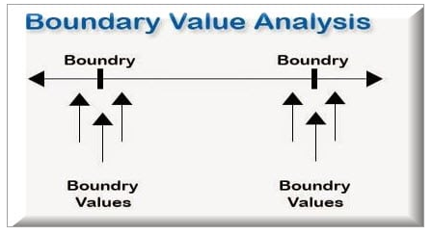

Slide 11
For Example
If we want to test a field where values from 1 to 100 should be accepted, then we choose the boundary values: 1-1, 1, 1+1, 100-1, 100, and 100+1. Instead of using all the values from 1 to 100, we just use 0, 1, 2, 99, 100, and 101.

Slide 12
2) Equivalence Partitioning
This technique is also known as Equivalence Class Partitioning (ECP). In this technique, input values to the system or application are divided into different classes or groups based on its similarity in the outcome.
Hence, instead of using each and every input value, we can now use any one value from the group/class to test the outcome. This way, we can maintain test coverage while we can reduce the amount of rework and most importantly the time spent.

Slide 13
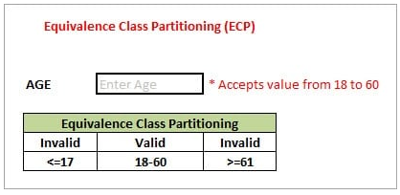
For Example: As present in the below image, the “AGE” text field accepts only numbers from 18 to 60. There will be three sets of classes or groups.

Slide 14
Two invalid classes will be:
a) Less than or equal to 17.
b) Greater than or equal to 61.
A valid class will be anything between 18 and 60.
We have thus reduced the test cases to only 3 test cases based on the formed classes thereby covering all the possibilities. So, testing with any one value from each set of the class is sufficient to test the above scenario.

Slide 15
The equivalence classes will be as follows:
Class I=> invalid class: < 25
Class II => valid class: 25 t0 50
Class III => invalid class: > 50

Slide 16
State Transition Testing
State Transition Testing is a technique that is used to test the different states of the system under test. The state of the system changes depending upon the conditions or events. The events trigger states which become scenarios and a tester needs to test them.
A systematic state transition diagram gives a clear view of the state changes but it is effective for simpler applications. More complex projects may lead to more complex transition diagrams thereby making it less effective.

Slide 17
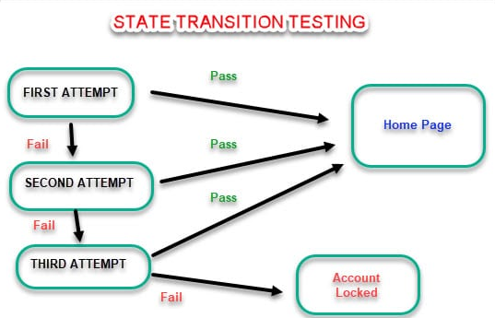
For Example: Verification of ATM pin

Slide 18
Exercise/TD
(1) Consider that, the maximum verification of an ATM pin is five (5). Assuming you were to use state transition testing to verify the maximum entering of ATM pin. Depict the graphical illustration of the scenario.
(2) In an Examination, a candidate has to score a minimum of 25 marks in order to pass the exam. The maximum that he can score is 50 marks.
(a) Identify and explain Equivalence values if the student passes the exam.
(b) Identify and explain Equivalence values for processing the student marks
(3) Below are four faulty programs. Each includes test inputs that result in failure. Answer the following questions about each program.

Slide 19
Exercise/TD
(a) Explain what is wrong with the given code. Describe the fault precisely by proposing a modification to the code.
(b) If possible, give a test case that does not execute the fault. If not, briefly explain why not.
(c) If possible, give a test case that executes the fault, but does not result in an error state.
If not, briefly explain why not.
(d) If possible give a test case that results in an error state, but not a failure. Hint: Don’t forget about the program counter. If not, briefly explain why not.
(e) For the given test case, describe the first error state. Be sure to describe the complete state

Slide 20
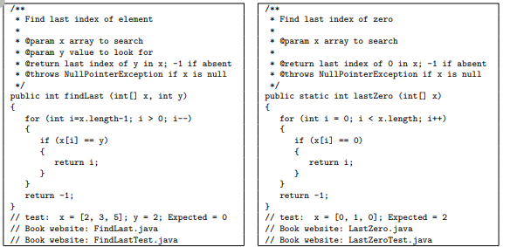
Exercise/TD

Slide 21
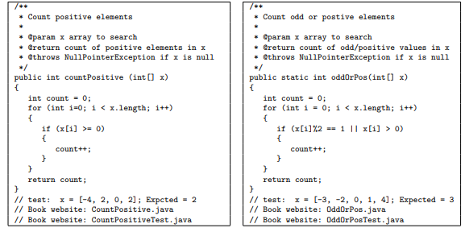

Slide 22
Exercise/TD Answer
The equivalence classes will be as follows:
Class I=> invalid class: < 25
Class II => valid class: 25 t0 50
Class III => invalid class: > 50
We need to identify Valid Equivalence values. Valid Equivalence values will be there in a Valid Equivalence class. All the values should be in Class II.

Slide 23
Decision Table Testing

Slide 24
We know that Black box testing involves validating the system without knowing its internal design.
Moreover, we have also discussed that Boundary Value Analysis and Equivalence Partitioning can only handle one input condition at a time.
So what do we do if we need to test complex business logic where multiple input conditions and actions are involved? Consequently, we will discuss another black box testing technique known as Decision Table Testing. Because this testing can handle such cases.

Slide 25
What is Decision Table Testing?
How to create a Decision Table?
Pitfalls of Decision Table Testing

Slide 26
What is Decision Table Testing?
We often test applications where the action is basis of multiple input combinations. E.g., if you are applying for a loan, then the eligibility for getting a loan will depend on several factors like age, Monthly Salary, loan amount required, etc.
Consequently, these combinations are called business logic based on which the application functionality works. The decision table is a black box testing technique that is used to test these complex business logic.

Slide 27
As the name itself suggests, wherever there are logical relationships like:
If {
(Condition = True)
then action1 ;
}
else action2; /*(condition = False)*/
Then a tester will identify two outputs (action1 and action2) for two conditions (True and False). So based on the probable scenarios a Decision table is carved to prepare a set of test cases.

Slide 28
It is a tabular representation of input conditions and resulting actions .i.e A decision table is a tabular representation of a decision situation, where the different combinations of alternative condition states and the resulting decisions are represented as columns in a table.
Additionally, it shows the causes and effects. Therefore, this technique is also called a cause-effect table.

Slide 29
Testing combinations can be a challenge, especially if the number of combinations is enormous.
Moreover, testing all combinations is not practically feasible as it's not cost and time effective. Therefore, we have to be satisfied with testing just a small subset of combinations. That is to say, the success of this technique depends on our choice of combinations

Slide 30
How to Create a Decision Table?
A decision table consists of four parts:
The conditions variables are the criteria which are relevant to the decision making process. They represent the items about which information is needed to take the right decision.
The condition states are the values the conditions can take: every condition has its set of condition states.
The actions describe the result of a decision.
The action values are the possible values for a given action

Slide 31
For example: If you are to apply for a loan in XYZ bank, then the eligibility for getting a loan will depend on several factors like age, Monthly Salary, loan amount required, etc.

Slide 32
Assignment
Team Work Presentation

